Slide 1

A Presentation On Student Profile Management System Course Title: Software Development Sessional
Course Code: CSE 302 Presented By Md. Mostafijur Rahman(1902073)
Hajee Mohammad Danesh Science and Technology University,
Dinajpur-5200

Slide 2

Outline
Introduction
Main Objectives
Tools and Technology
Modules
Database Design
Snapshots of Output
Limitation
Future work
Conclusion

Slide 3

Introduction
Project name: Student Profile Management System
Key Features of this project:
Now a days there is a need for Student Profile Management System software for managing of student’s data that will help to resolve the problems of conventional file processing system.
Our project provides the student registration and login facility
It can handle the details of student, courses details, subject details, exam details, result of all semester.
In this system, only admin and individual student can view details of students.
Login ID and password are maintained by the admin panels.

Slide 4

Objectives
The main objective of the system is to computerize the maintenance of the student details, course details, notices, results and other details of any department
Store and maintain the data of students securely
Student can Easily access to their account and can find the information's very fast.
They can able to see their details, notices, all courses they have and result of all semester in CGPA.
The departmental notice and general notice of institution are showing to each account which maintained by administrator.

Slide 5





Tools and Technology
Hardware Requirements:
Processor: 1 GHz Processor
RAM: 1GB (minimum required)
Hard Disk: 40 GB
Software Requirements:
Language: Java
For GUI: Java Toolkit- Java Swing
Backend: MySQL Local Server
Backend Software: XAMPP SQL Server
Environment: NetBeans IDE 8.2
Operating System: Windows 10 or Windows 11
Notes:
fskdjflsdjfslfjsdljd

Slide 6

Modules
Home Page
General Notice
Registration page
Login page
Student details
Departmental notice
Result
Courses

Slide 7

Database Design
For database we use XAMPP SQL Server
By Writing DDL and DML language we build a proper database for this project
Before creating database in XAMPP we perform database design phase to implement properly
Use case diagram and Entity Relationship Diagram are designed for this project

Slide 8
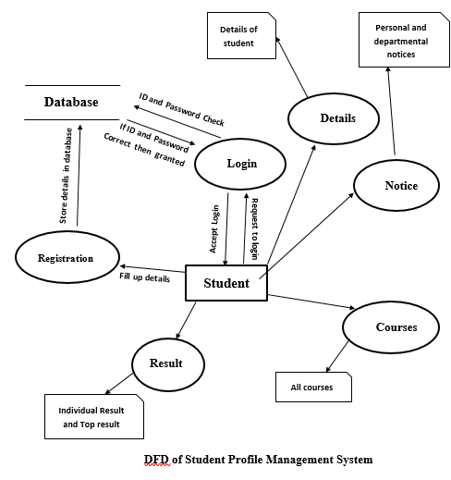
Data Flow Diagram
DFD Diagram of Student Profile Management System

Slide 9
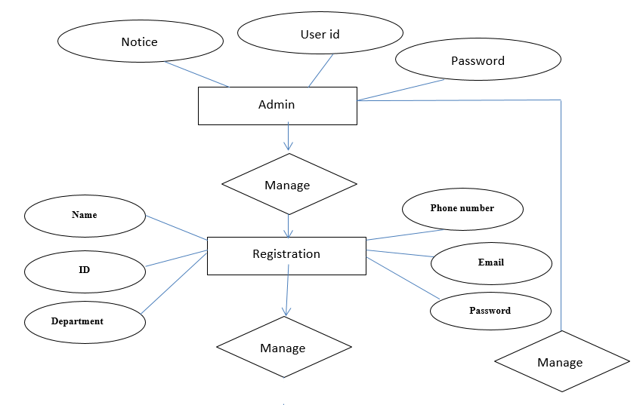
Entity Relationship Diagram
Figure: ER diagram (part-1)

Slide 10
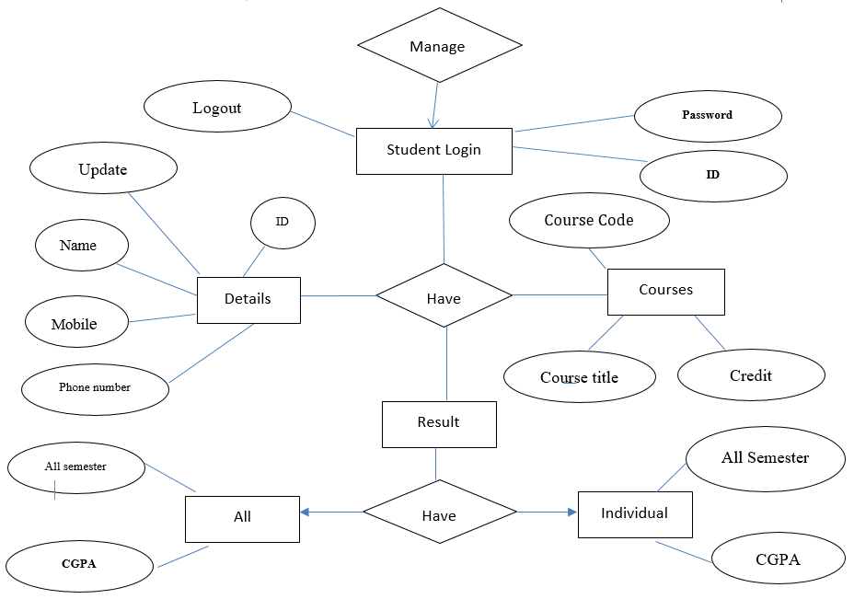
Entity Relationship Diagram
Figure: ER diagram (part-2)

Slide 11

Output
The outputs of different modules of our application are shown by the screenshots and also showing the explanation

Slide 12
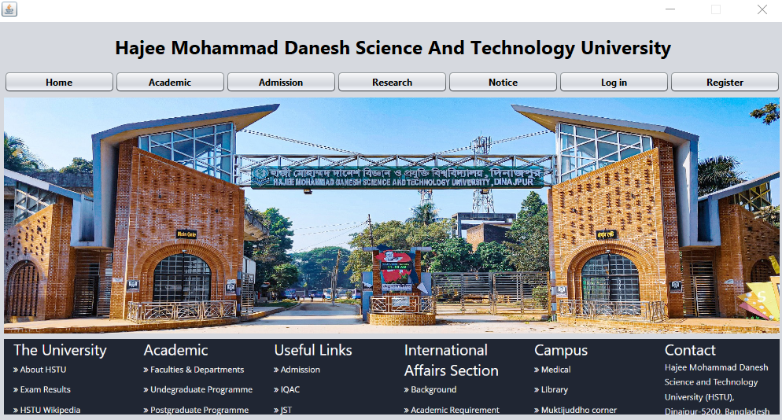
Home Page
Figure-1: Home page
12

Slide 13
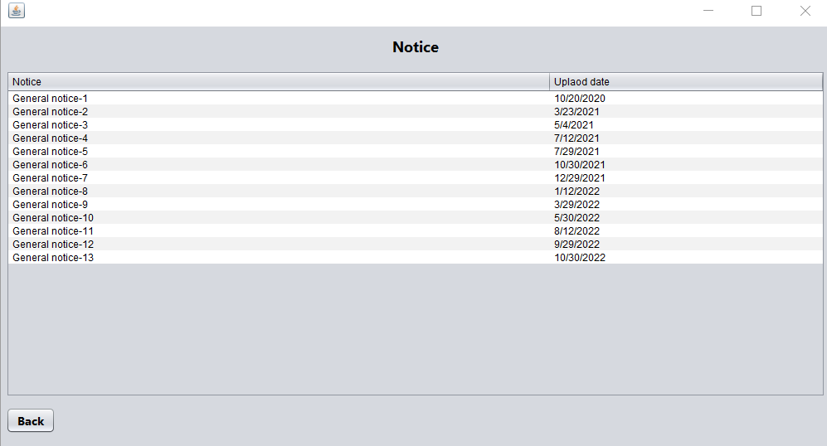
Notice page
Notice title and notice will show in this section
Notice publish date
Figure-2: Notice page
13

Slide 14
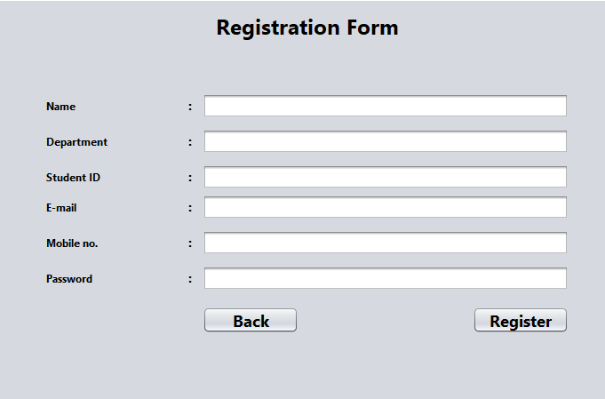
Student Registration Form
Name must be as Certificate name
Give your department, remember it’s can’t be change in future
Student ID, which is provided by the authority
Give an active mobile number
Give an strong password and remember it for further login
Click the register button to confirm registration
Figure-3: Student Registration Form

Slide 15
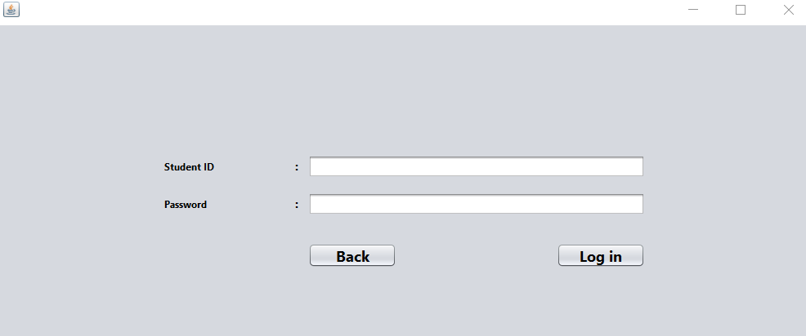
Login page
Give the student ID
Give correct password
Click Login button to log in
Figure-4: Login page

Slide 16
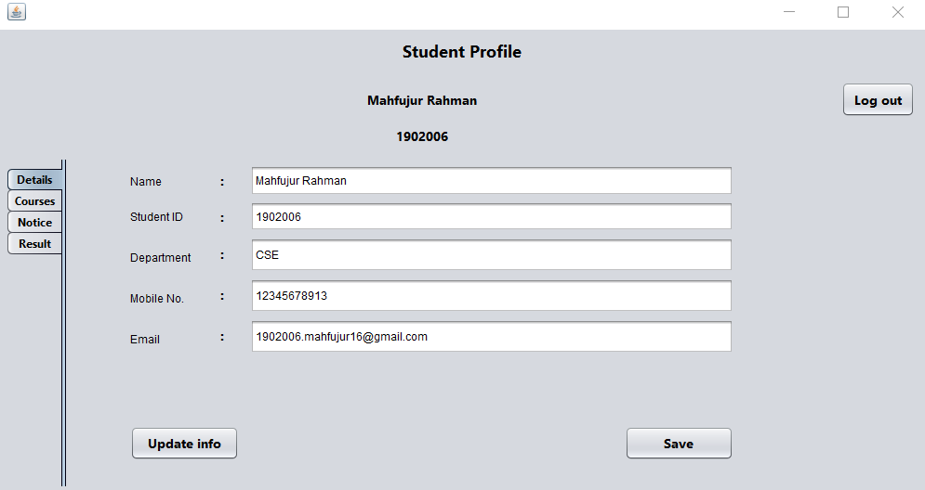
Student Profile
Student details page
Name, ID and Department are not changeable
Update only mobile no and email address
Figure-5: Student Profile
16

Slide 17
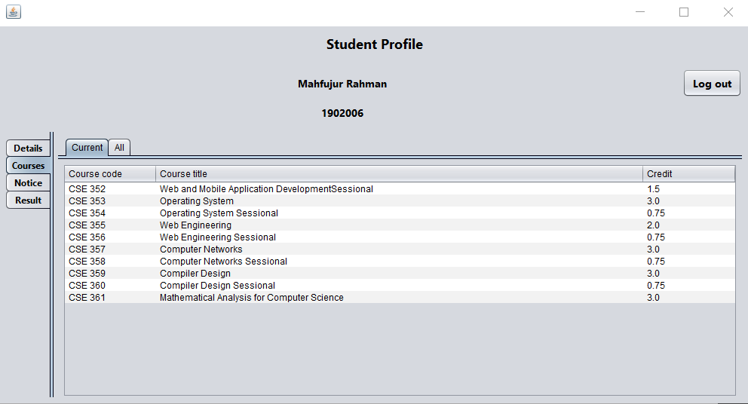
Courses
All Running Semester Courses
All Semester Course
Notes:
Randomly generates elements of the array and sorting them by using the proper data structures and algorithms and also showing their passes.

Slide 18
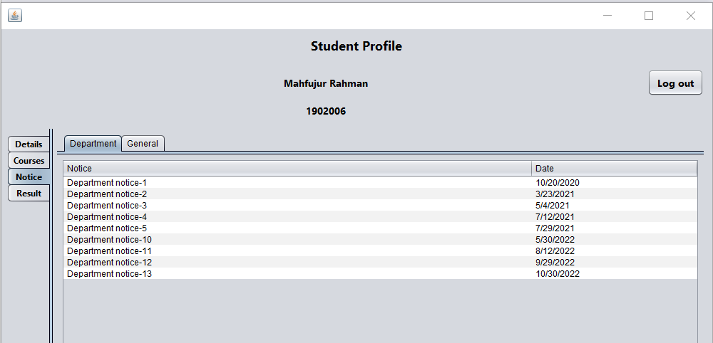
Departmental Notice
Department general notice
Departmental notice with date
Figure- 8: Departmental Notice
Notes:
Randomly generates elements of the array and sorting them by using the proper data structures and algorithms and also showing their passes.

Slide 19
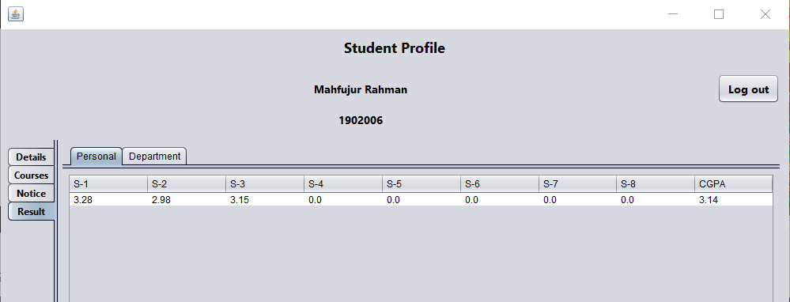
Results of Students(Individual)
Individual Student result of all semester with CGPA
Figure-9 : Result

Slide 20
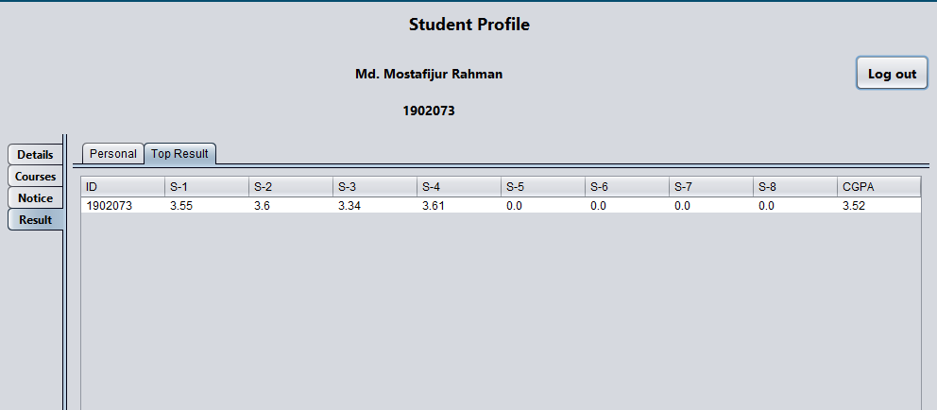
Top Result of the Department
Department Top results of with CGPA
Figure-10 : Department top result

Slide 21

Limitation
Admission and academic works are not performed in our project
Notices that are up to dated is not updated by teachers.
Student cannot upload or download research paper or their notes

Slide 22
Future work
In Future we will design a web based application with more facilities
The Controlling System will be increased
Academic and Admission system panel will be improved
Student can upload or download notes

Slide 23

Conclusion
Main goal of this project is to help the university system online based.
Using this system one student can find any important information related his/her subject easily and efficiently.
The visitors don’t see the any departmental details.

Slide 24
THANK You!

